Slide 1
Airbnb Price & Review Analysis Dashboard
Data Analysis Project Using Python & Power BI

Slide 2
PROJECT OVERVIEW
This project analyzes Airbnb listing data to understand pricing patterns, customer ratings, and host characteristics.
The project was completed in two main stages:
Data Cleaning & Preprocessing using Python
Data Visualization & Dashboard Creation using Power BI
Total Listings Analyzed: 212,000+

Slide 3
TOOLS & TECHNOLOGIES USED
Tools & Technologies
Python (Data Cleaning & Preprocessing)
Pandas (Data manipulation)
Power BI (Dashboard creation)
DAX (Calculated measures & KPIs)
This combination allowed efficient data preparation and powerful visualization.

Slide 4
DATA CLEANING PROCESS (PYTHON)
The raw dataset contained missing values, inconsistent formats, and unnecessary columns.
Steps performed using Python:
Removed missing/null values
Cleaned price column (removed symbols, converted to numeric)
Handled incorrect data types
Removed duplicates
Standardized categorical values
Created new calculated columns
Exported cleaned dataset for Power BI
Python helped ensure accurate and reliable analysis.

Slide 5
BUSINESS OBJECTIVES
This analysis aims to answer:
What factors influence Airbnb listing prices?
Does review score affect pricing?
Do Superhosts charge more?
Which room type generates the highest average price?
How does neighbourhood impact pricing?
How does guest capacity influence price?

Slide 6
DATASET DESCRIPTION
Key Columns Used:
price
review_scores_rating
room_type
neighbourhood
accommodates
minimum_nights
host_is_superhost
After cleaning in Python, the dataset was imported into Power BI for visualization.

Slide 7
KEY PERFORMANCE INDICATORS (KPIs)
Dashboard KPIs
Average Price: 145.89
Average Review Score: 65.08
Total Listings: 212K
Average Price per Guest: 59.45
These KPIs provide a quick summary of overall market performance.

Slide 8
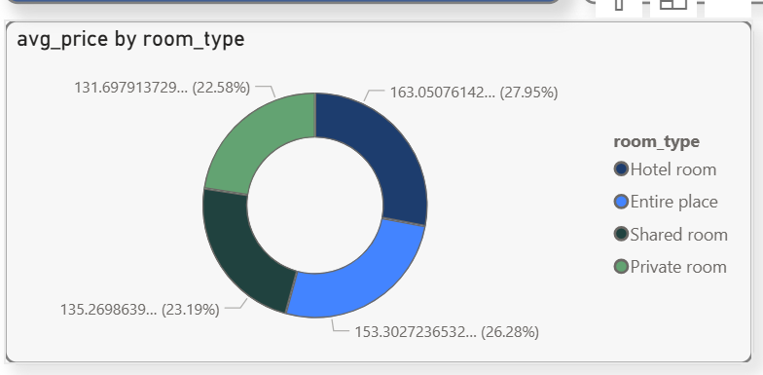
PRICE BY ROOM TYPE
Room Types:
Entire Place
Private Room
Shared Room
Hotel Room
Insights:
Hotel rooms have the highest average price.
Entire places are also priced higher.
Shared rooms are the most affordable.
Room type is a major price determinant.

Slide 9
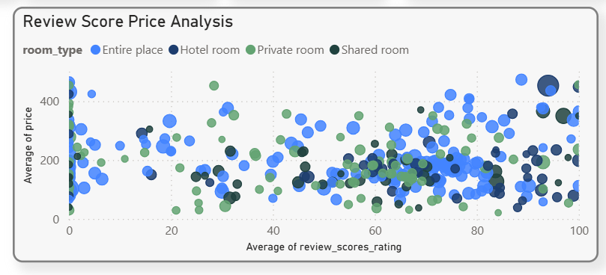
REVIEW SCORE VS PRICE ANALYSIS
Chart Setup:
X-Axis: Average Review Score
Y-Axis: Average Price
Bubble Size: Accommodates
Legend: Room Type
Insights:
Higher review scores do not always guarantee higher prices.
Entire places maintain strong review scores.
Guest capacity influences price.

Slide 10
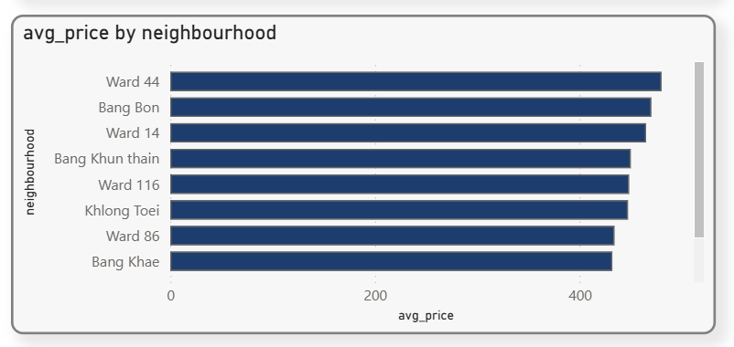
PRICE BY NEIGHBOURHOOD
Average Price by Neighborhood
Insights:
Location strongly influences price.
Premium neighborhoods charge significantly higher prices.
Geographic factors affect market positioning.

Slide 11
KEY FINDINGS
Major Insights
Location is a primary price driver.
Room type significantly impacts pricing.
Superhosts earn slightly higher prices.
Entire place listings dominate the market.
Review scores have moderate impact on pricing.
Guest capacity increases revenue potential.

Slide 12
CONCLUSION
This project demonstrates how:
Python improves data quality through cleaning and preprocessing.
Power BI transforms data into meaningful insights.
Data-driven decisions can optimize pricing strategy.
The dashboard provides clear, actionable insights for hosts and investors.

Slide 13
FUTURE IMPROVEMENTS
Future Enhancements
Price prediction model using Machine Learning
Seasonal trend analysis
Revenue forecasting
Occupancy rate analysis
Customer segmentation analysis

Slide 14
Thank You
Kum Fatema

